Slide 1
A tiny Search Engine for info.ruc.edu.cn
罗碚 2019201415

Slide 2
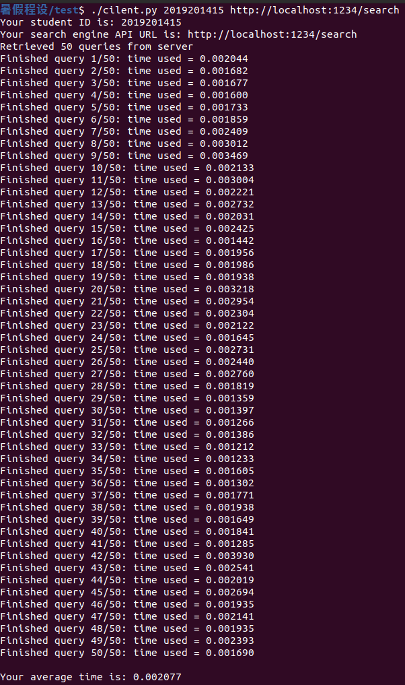
Main Methods and TOOls
BFS
cpp-jieba
TF-IDF
VSM
Word2vec-cpp
cpp-httplib
All written by C++, so it’s so fast that average 2ms for one query.

